Slide 1


Informatica Data Quality Bad Record Management

Slide 3
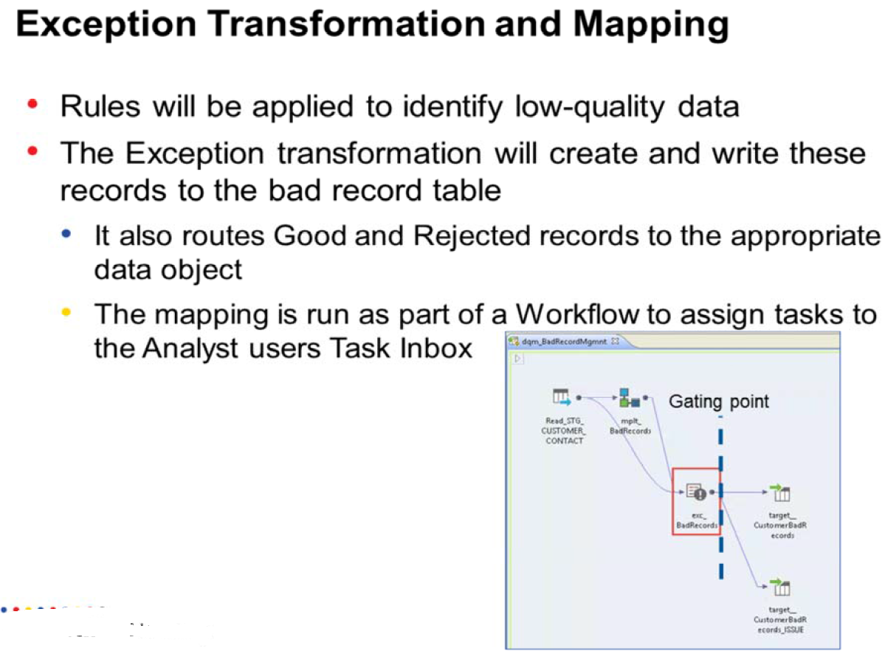

Slide 6
Task 1 : IDQ Bad Record Management- Create New Mapplet

Slide 7
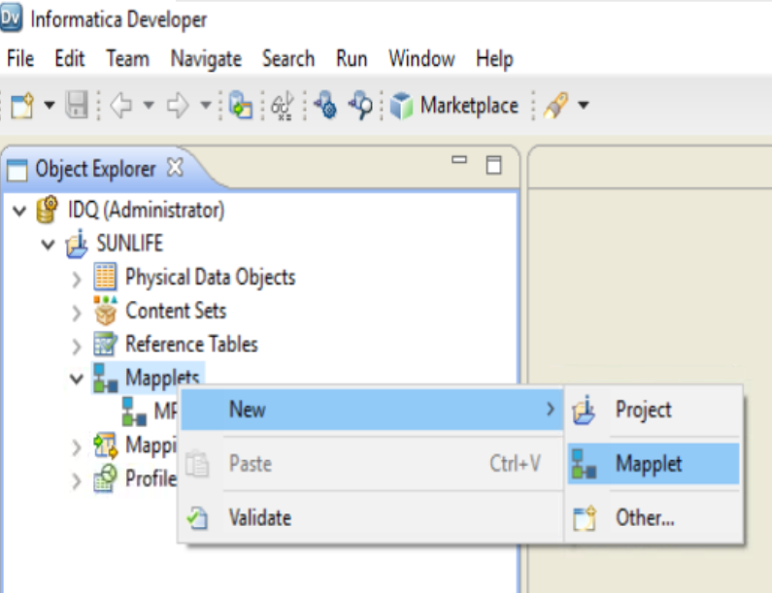
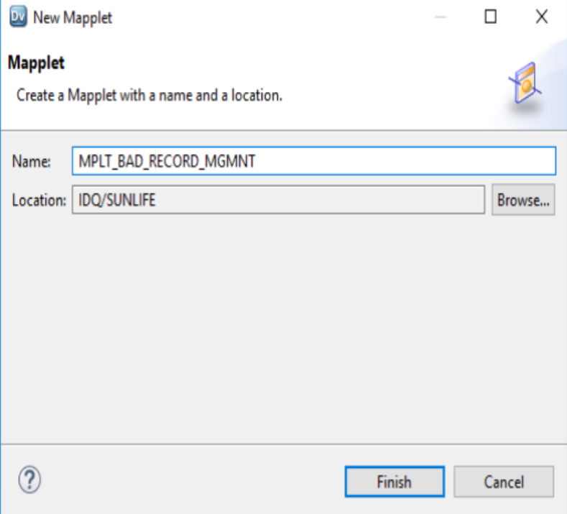
Step 1 : Create New MAPPLET
Name : MPLT_BAD_RECORD_MGMNT

Slide 8
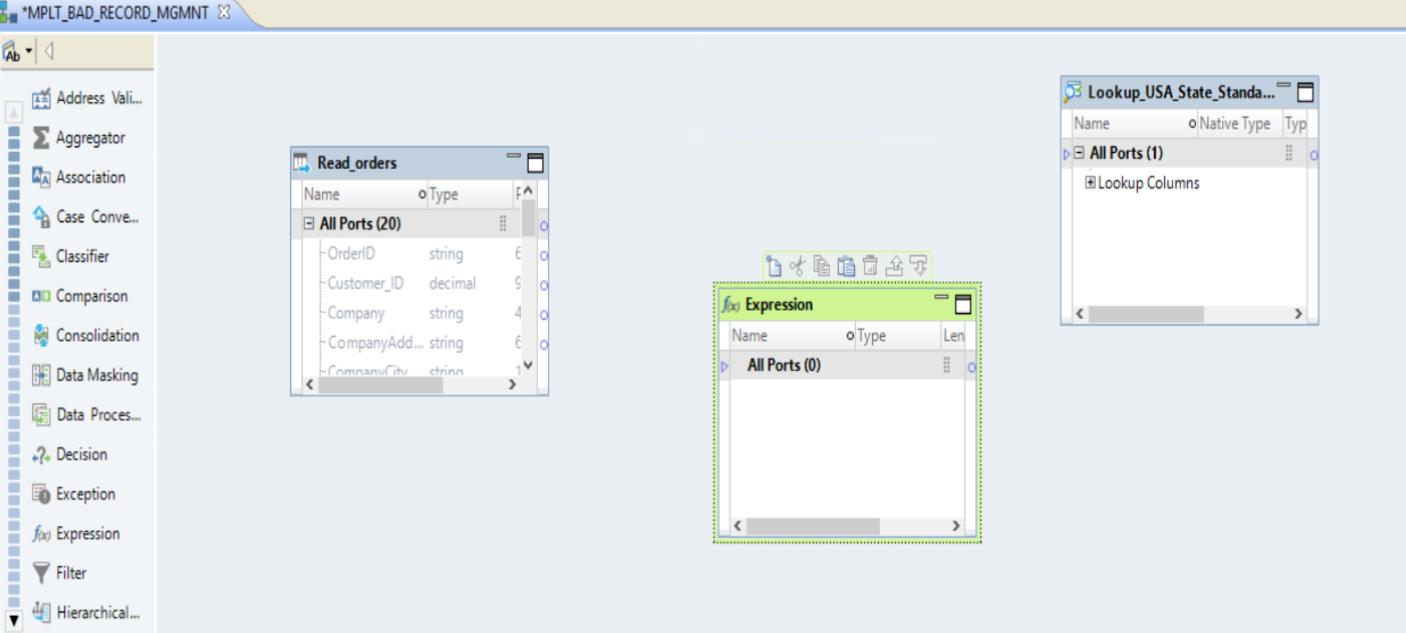
Step 2 : Configure MAPPLET
Source : ADD ORDERS (read ) + Expression Transformation + Lookup Transformation ( USA_STATE_STANDARD ➔ Reference Table)

Slide 9
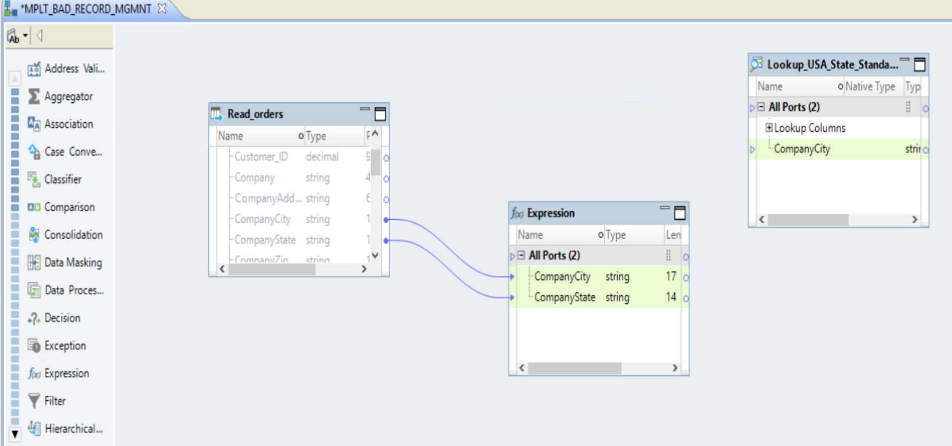
Step 3 : Configure MAPPLET
From Source : ORDERS (read ) ➔ Drag Company State and Company City Column to Expression Transformation
From Source : ORDERS (read ) ➔ Drag Company City Column to Lookup Transformation ( USA_STATE_STANDARD) ➔ Input Column ➔ Delete the Link between ORDERS AND LOOKUP

Slide 10
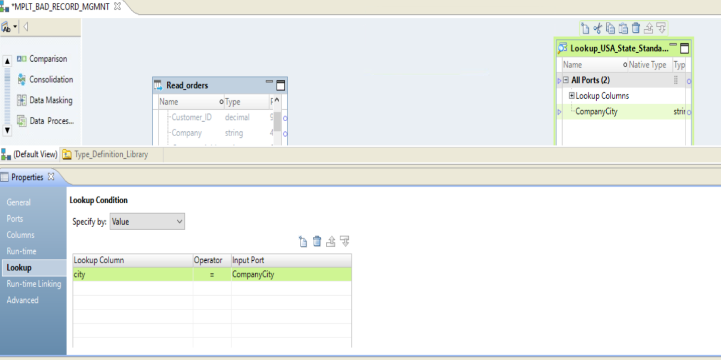
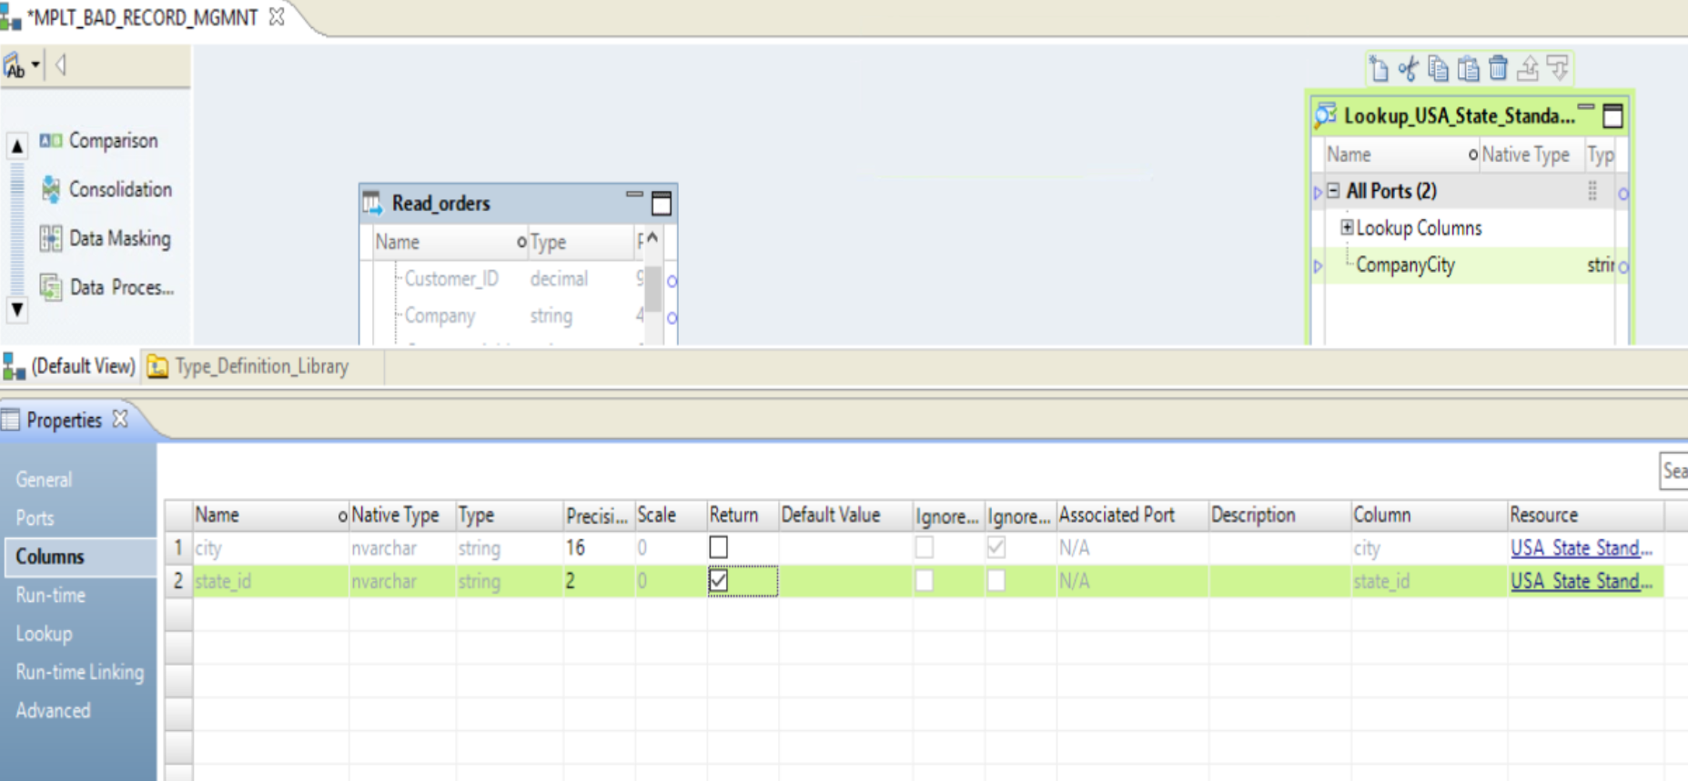
Step 3 : Configure MAPPLET ➔ Configure Lookup Transformation ➔ Right Click Lookup ➔ Properties
➔ Lookup Transformation ➔ Properties ➔ Lookup ➔ COLUMNS ➔ STATE_ID ➔ RETURN PORT ➔ UNCONNECTED LOOKUP
➔ Lookup Transformation ➔ Properties ➔ Lookup ➔ condition ➔ city match Companycity Column

Slide 11
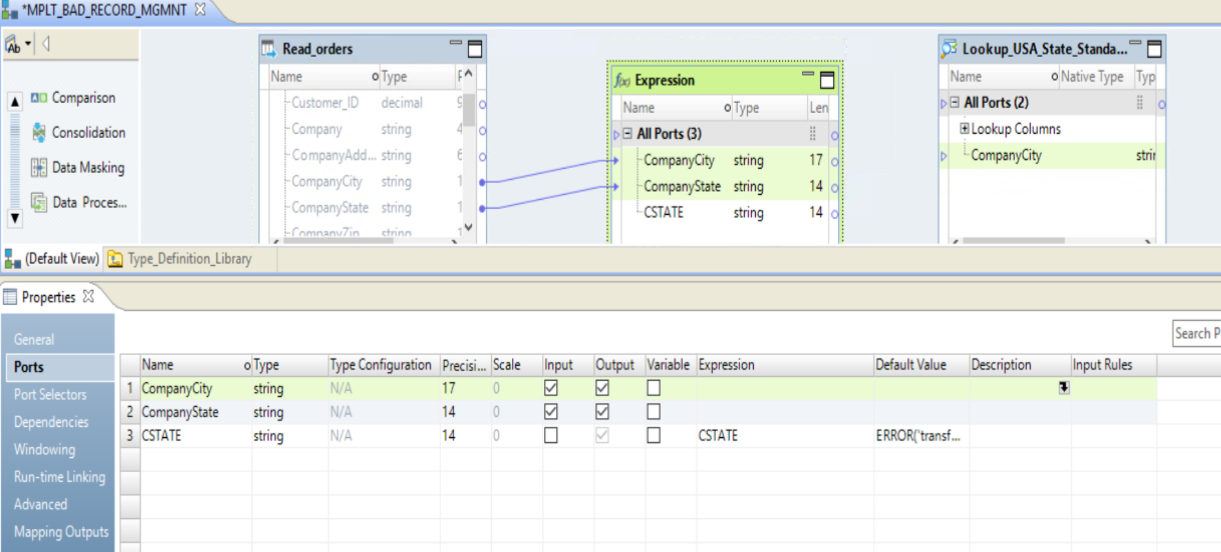
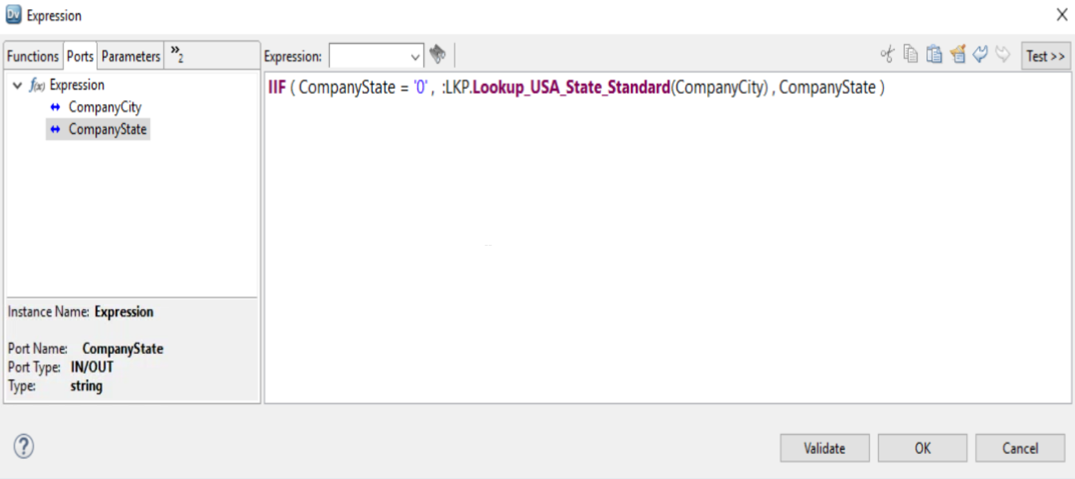
Step 3 : Configure MAPPLET ➔ Configure EXPRESSION Transformation ➔ Right Click Lookup ➔ Properties
➔ Apply Expression for CSTATE Column using UNCONNECT LOOKUP TRANSFORMATION AS FUNCTION
➔ Expression Transformation➔ Properties ➔ ports ➔ ADD NEW PORT ➔ CSTATE ➔ STRING ➔ 14

Slide 12
TASK 1B: Run Data Viewer - Expression

Slide 13
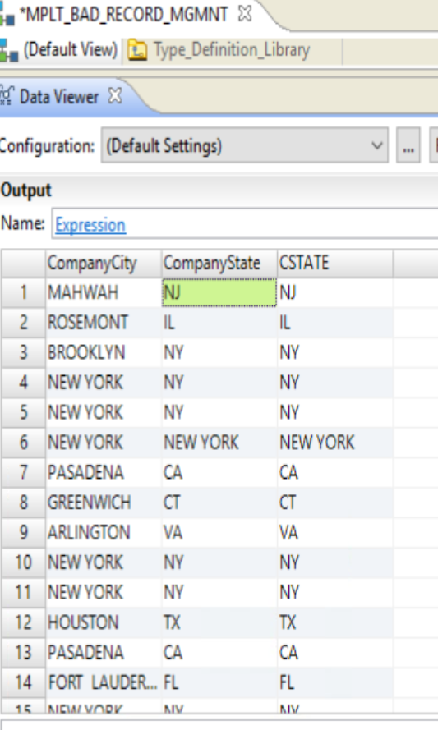
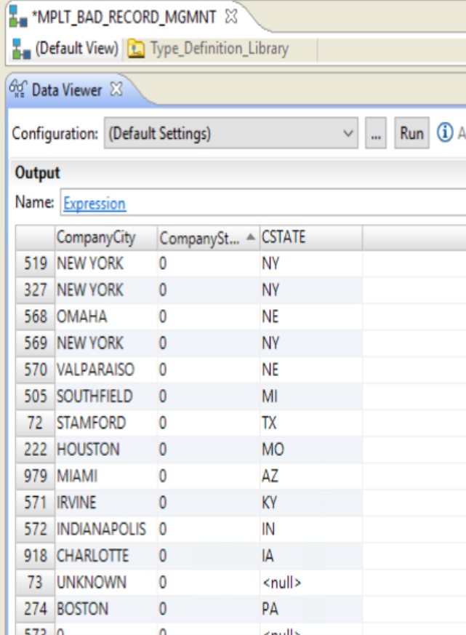

Slide 14
TASK 1C: Create Reference Table ➔ Company, State , City , Zip and Country

Slide 15
Task 1D: Add Labeler Transformation

Slide 16
Configure Labeler Transformation ➔ Company,city,state, Zip and Country

Slide 17
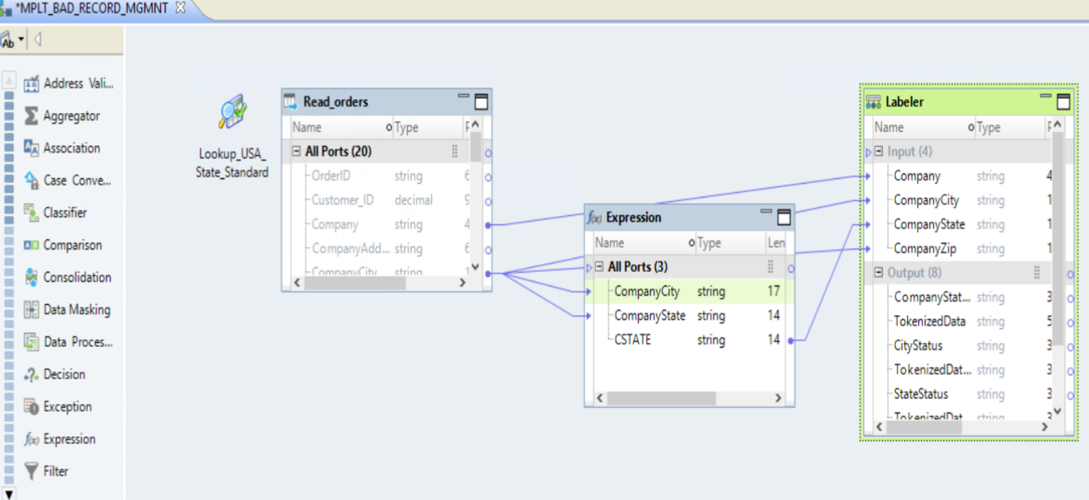
Step 1 : Configure MAPPLET ➔ ADD LABELER TRANSFORMATION TO VALIDATE COMPANY , STATE, CITY, and zip using Reference Table

Slide 18
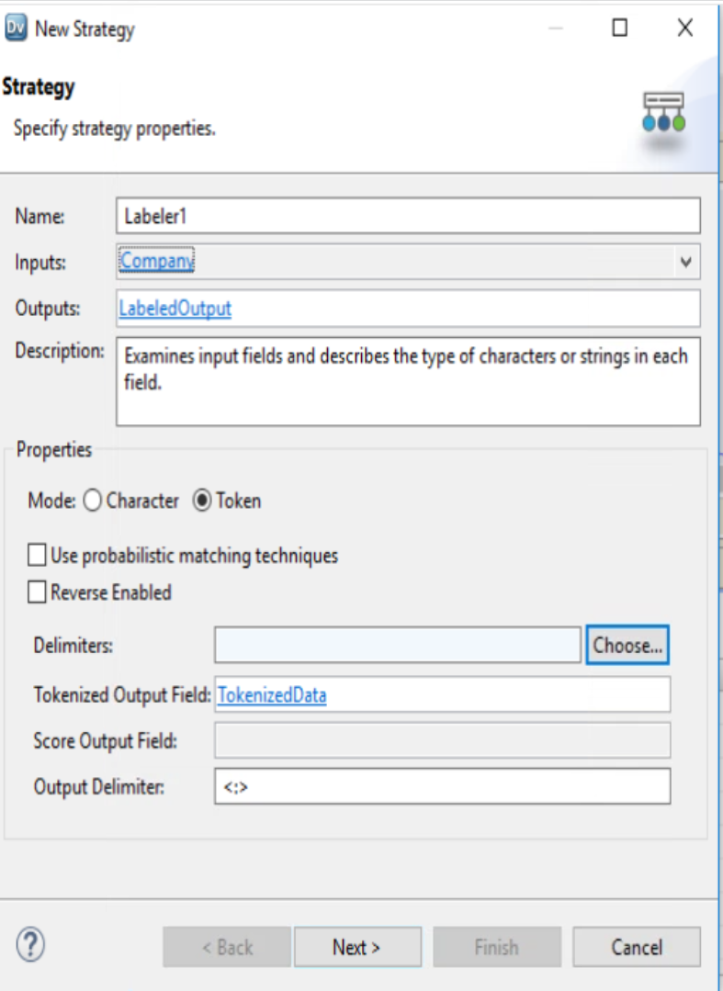
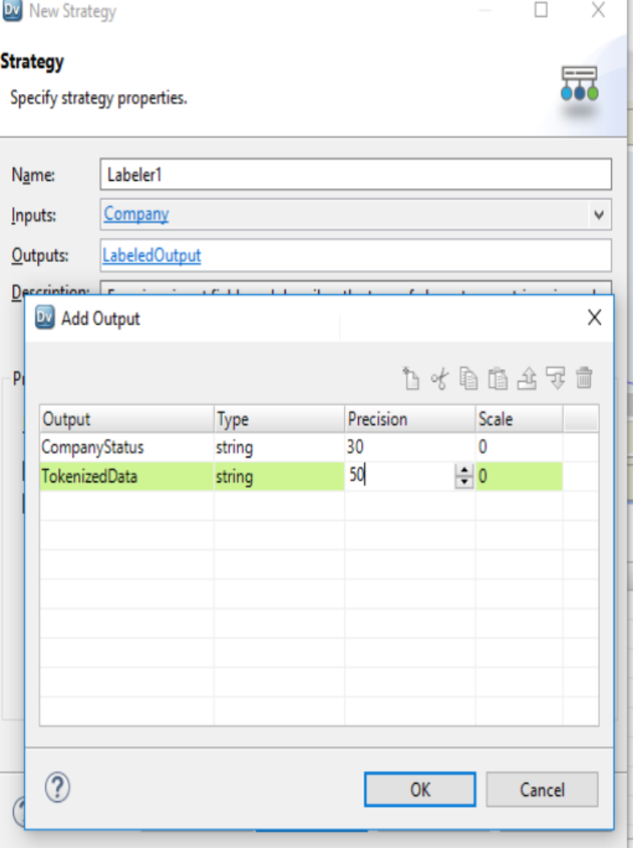
Step 2 : Configure LABELER TRANSFORMATION TO VALIDATE COMPANY , STATE, CITY, and zip using Reference Table

Slide 19
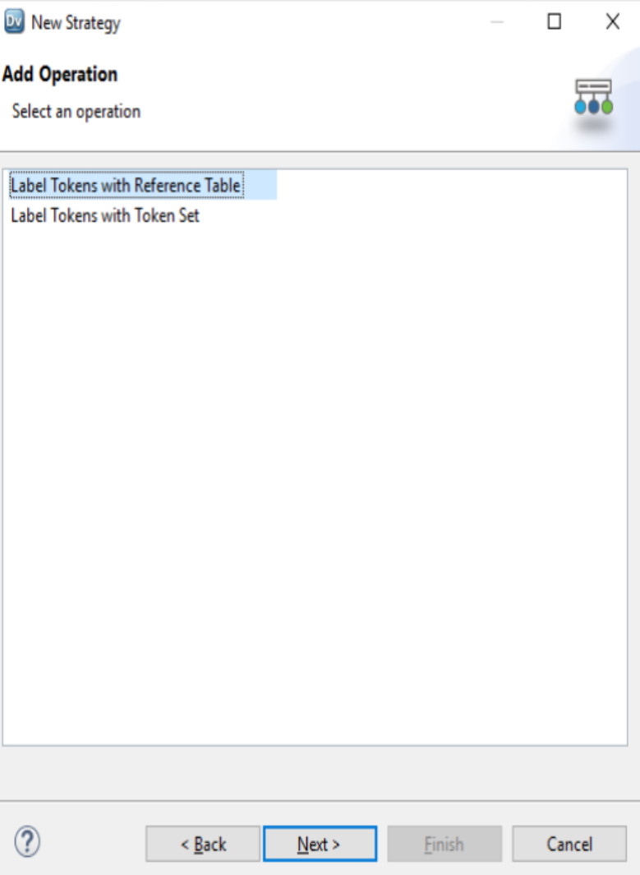
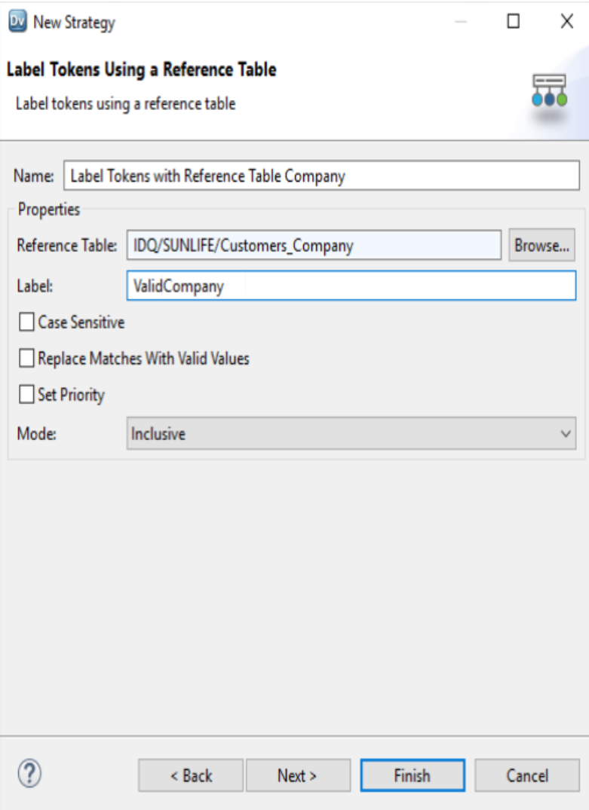
Step 2 : Configure LABELER TRANSFORMATION TO VALIDATE COMPANY , STATE, CITY, and zip using Reference Table

Slide 20
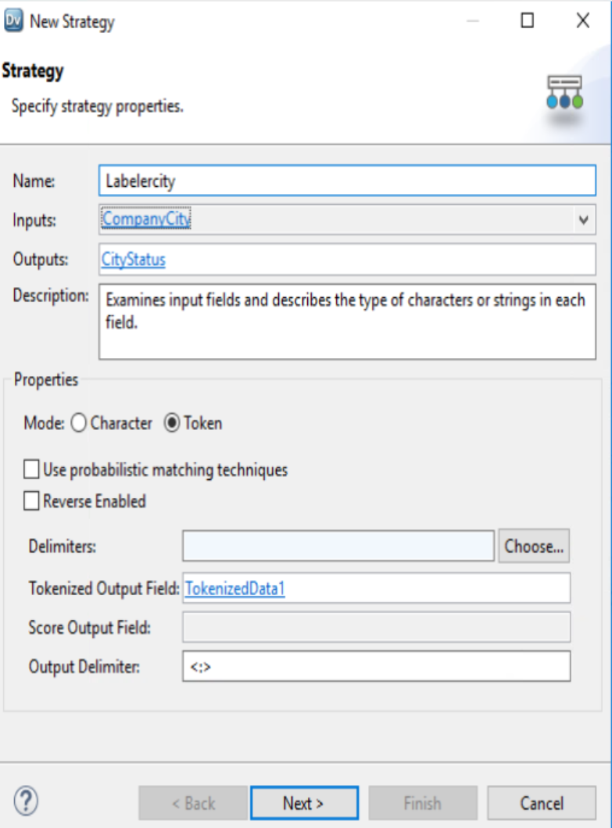
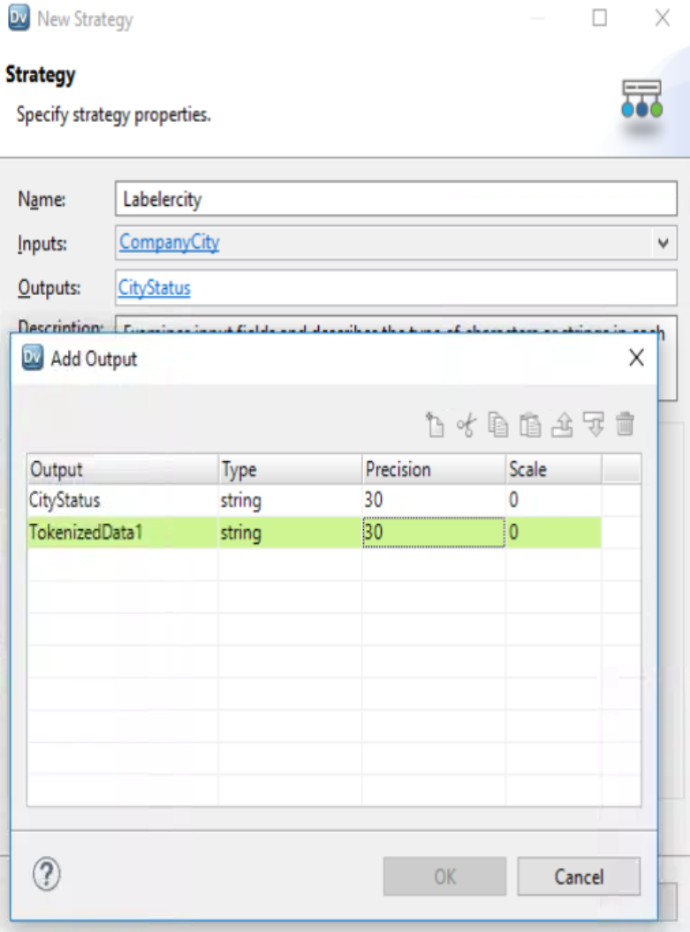
Step 2 : Configure LABELER TRANSFORMATION TO VALIDATE COMPANY , STATE, CITY, and zip using Reference Table

Slide 21
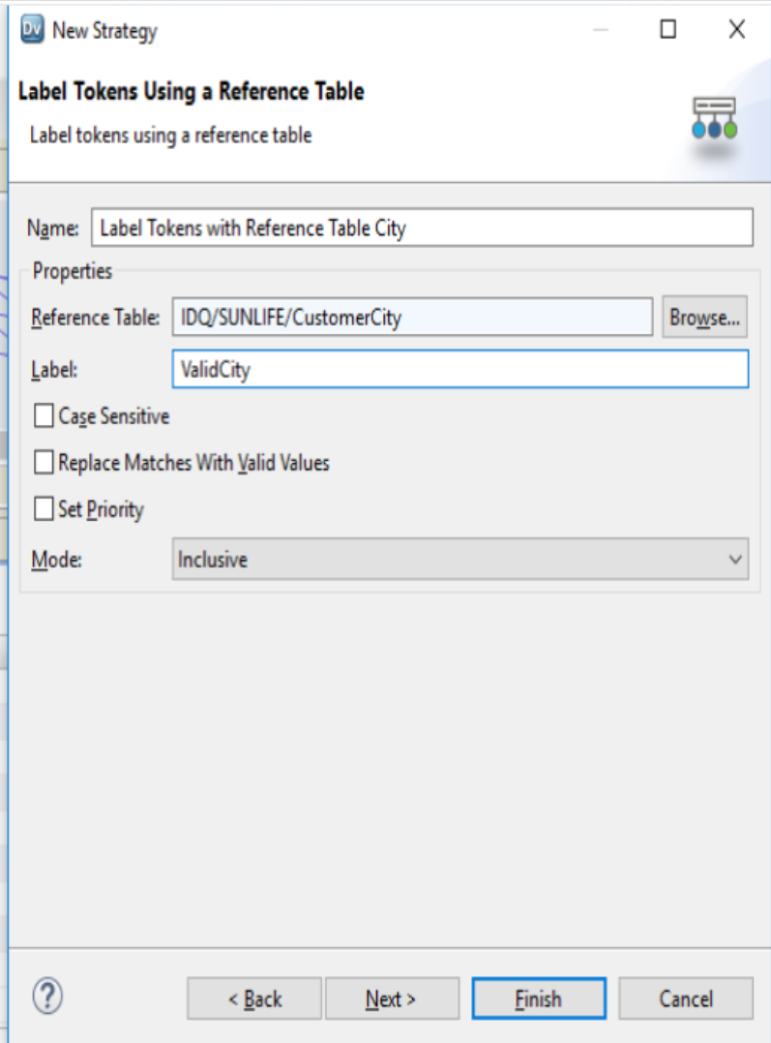
Step 2 : Configure LABELER TRANSFORMATION TO VALIDATE COMPANY , STATE, CITY, and zip using Reference Table

Slide 22
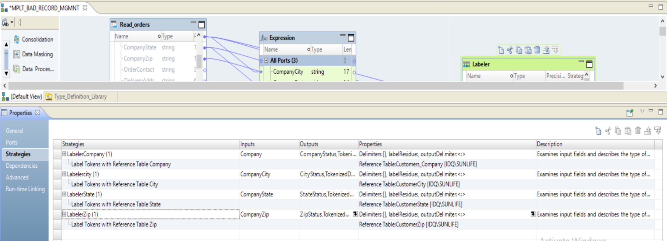
Step 2 : Configure LABELER TRANSFORMATION TO VALIDATE COMPANY , STATE, CITY, and zip using Reference Table

Slide 23
TASK 1E: Run Data Viewer - LABELER

Slide 24
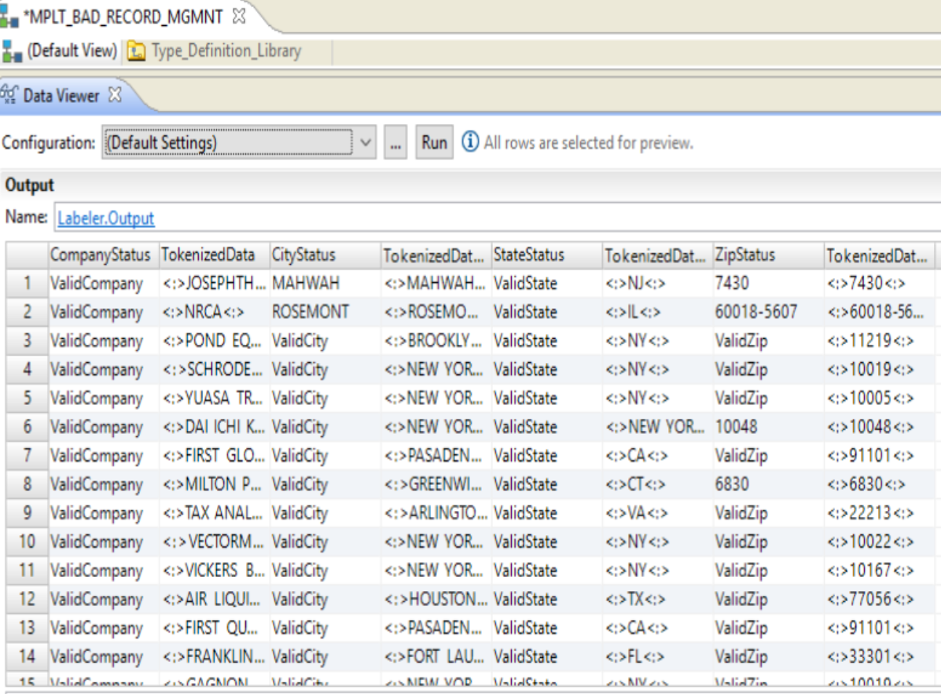
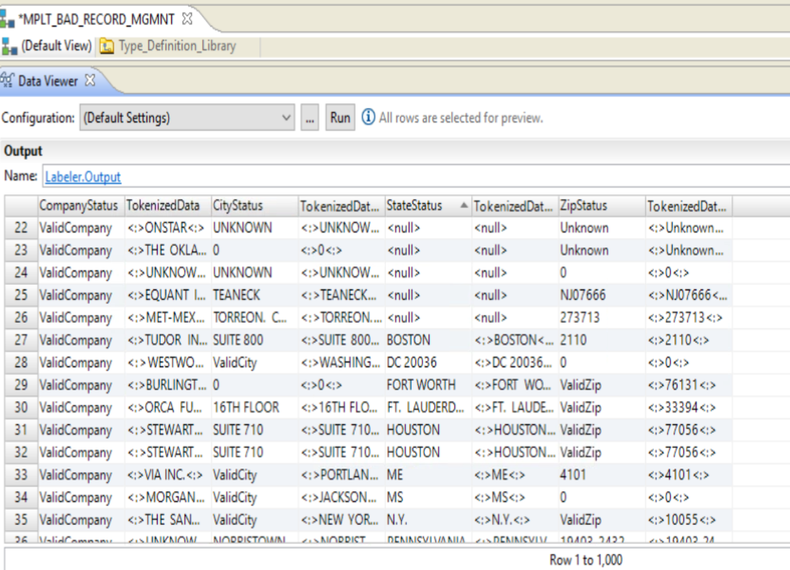

Slide 25
TASK 1F : ADD Decision Transformation to Achieve Score

Slide 26
Bad Data Mapplet ➔ Configure Decision Transformation ➔ Assign Score 10 for Invalid Company, City, State ,Zip & Country ➔ Assign Score 20 for Invalid City, State ,Zip & Country and valid Company ➔ Assign Score 30 for Invalid State ,Zip & Country and valid Company & City ➔ Assign Score 40 for Invalid Zip & Country and valid Company ,City & State ➔ Assign Score 50 for Invalid Country and valid Company , City , State & zip ➔ Assign Score 100 for Valid Record

Slide 27
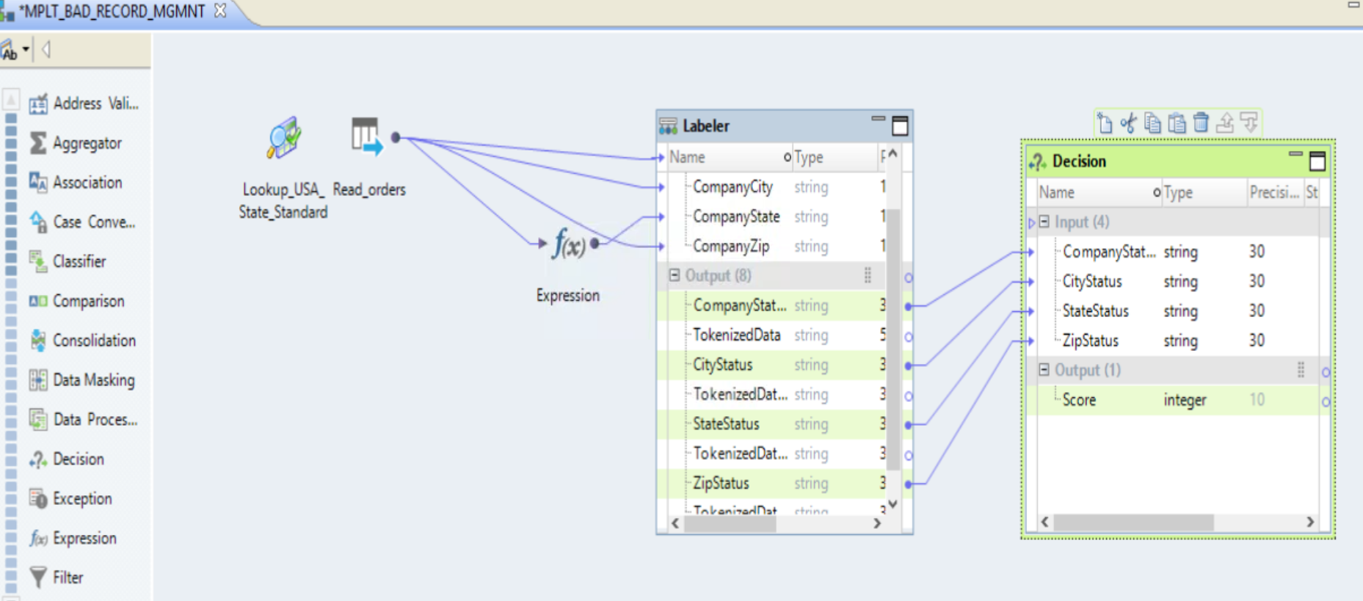
Step 1 : Configure DECISION Transformation
Drag CompanyStatus, CityStatus, StateStus, ZipStatus column as INPUT TO DECISION TRANSFORMATION
CREATE A NEW OUTPUT PORT SCORE ➔ INTEGER ➔ 10

Slide 28
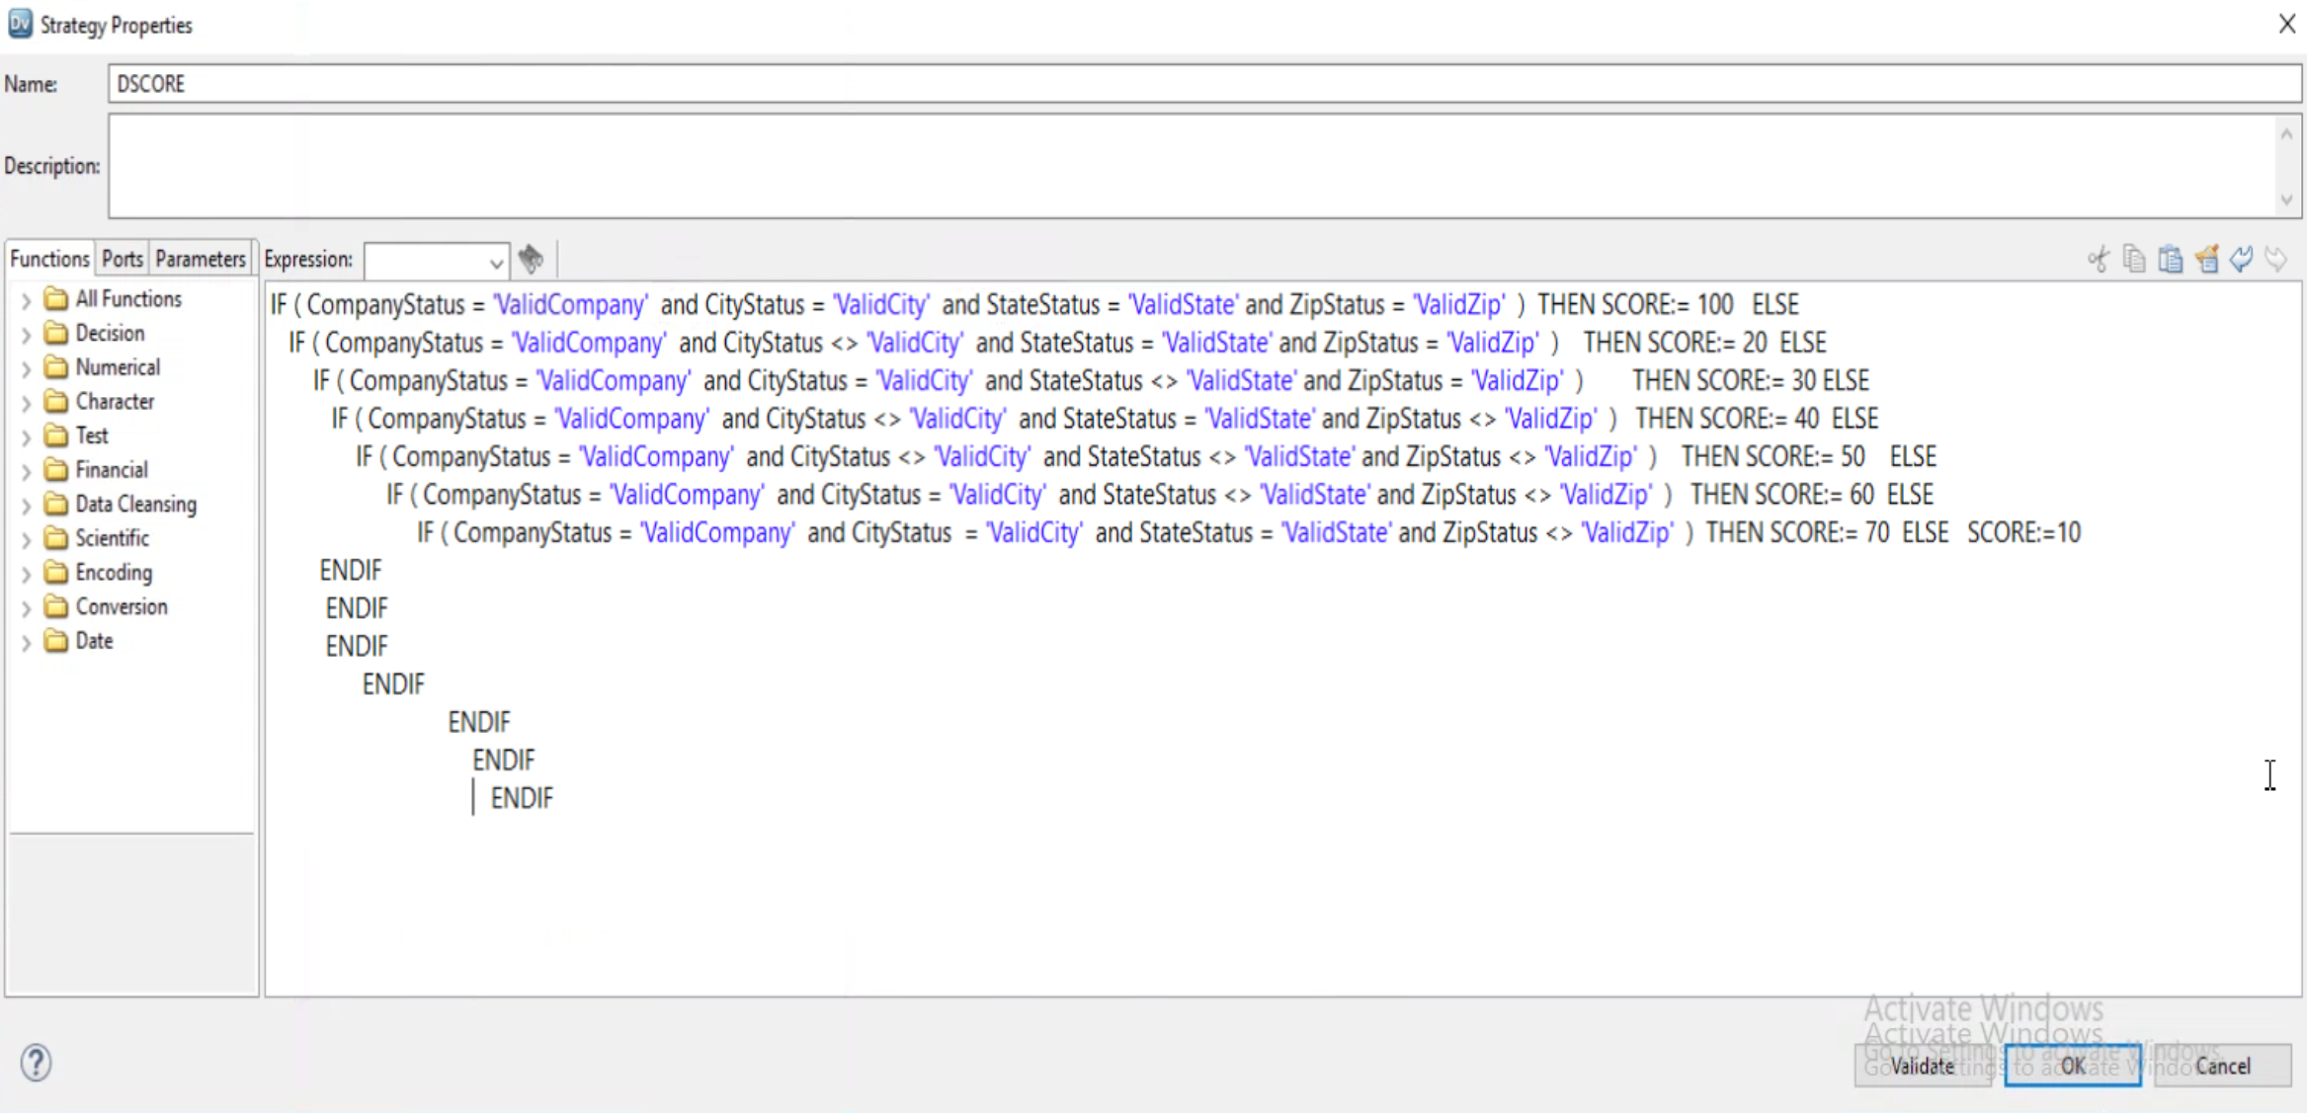
Step 1 : Configure DECISION Transformation ➔ Properties

Slide 29
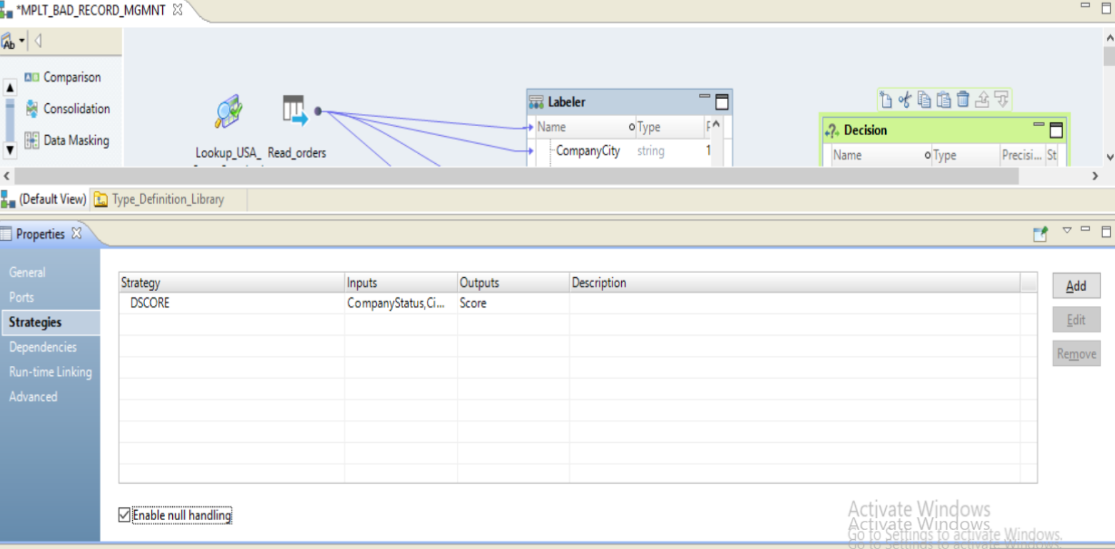
Step 1 : Configure DECISION Transformation ➔ Properties

Slide 30
Task 1F : Add Expression Transformation for view input and LABELER Status and Decision Score

Slide 31
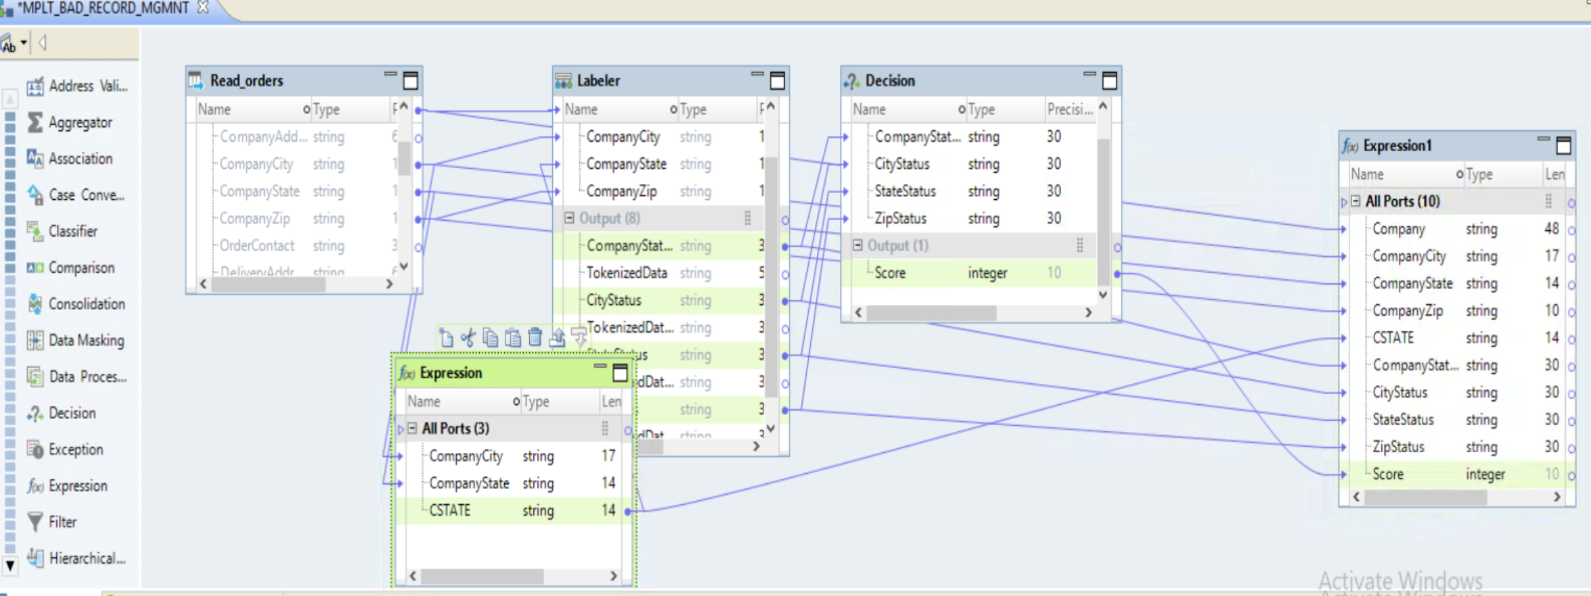
Step 1 : ADD Expression Transformation
➔ Drag Company, city and zip from Source orders
Drag State from Expression Transformation
Company, state ,city and zip ( status) from Labeler Transformation to Expression
Drag Score from Decision Transformation based on Valid Status of (Company,state,city and Zip )

Slide 32
TASK 1G : Run data viewer from Expression Transformation

Slide 33
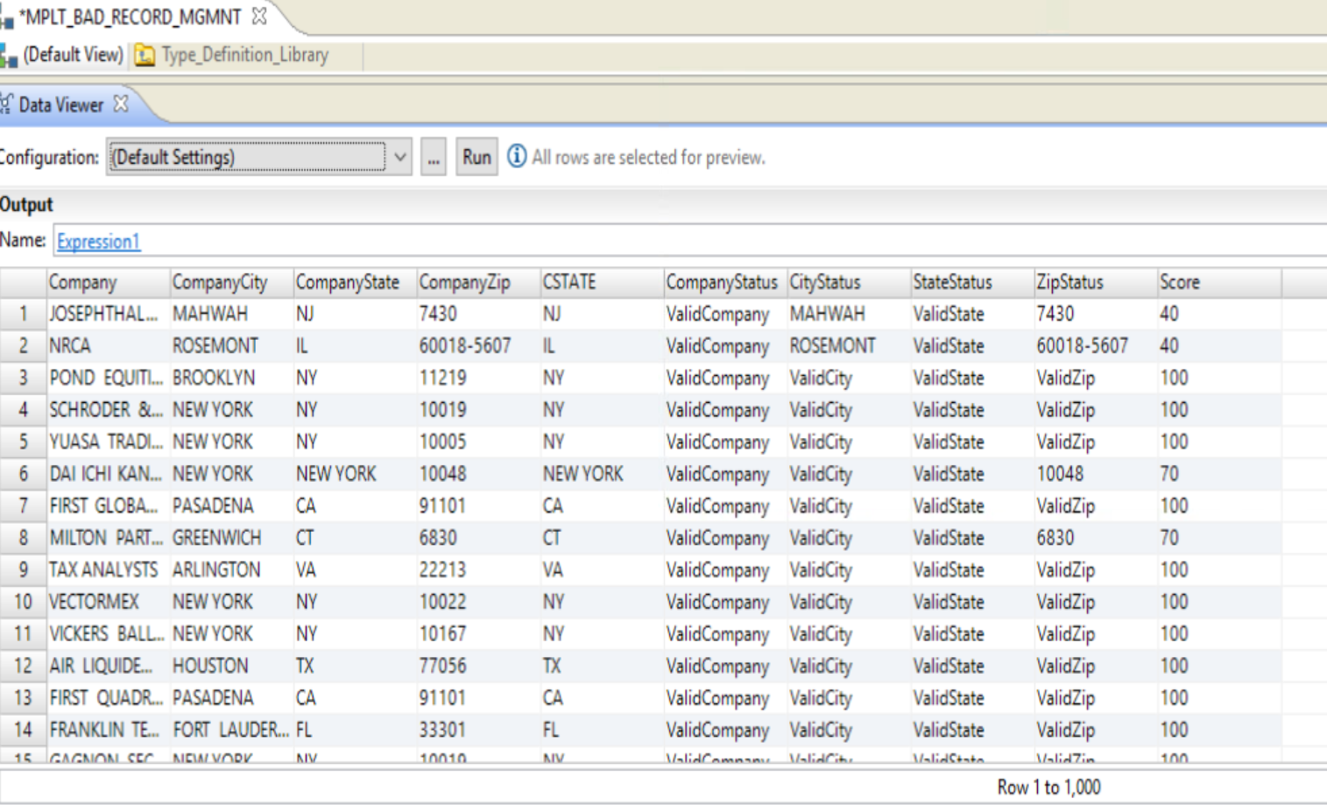
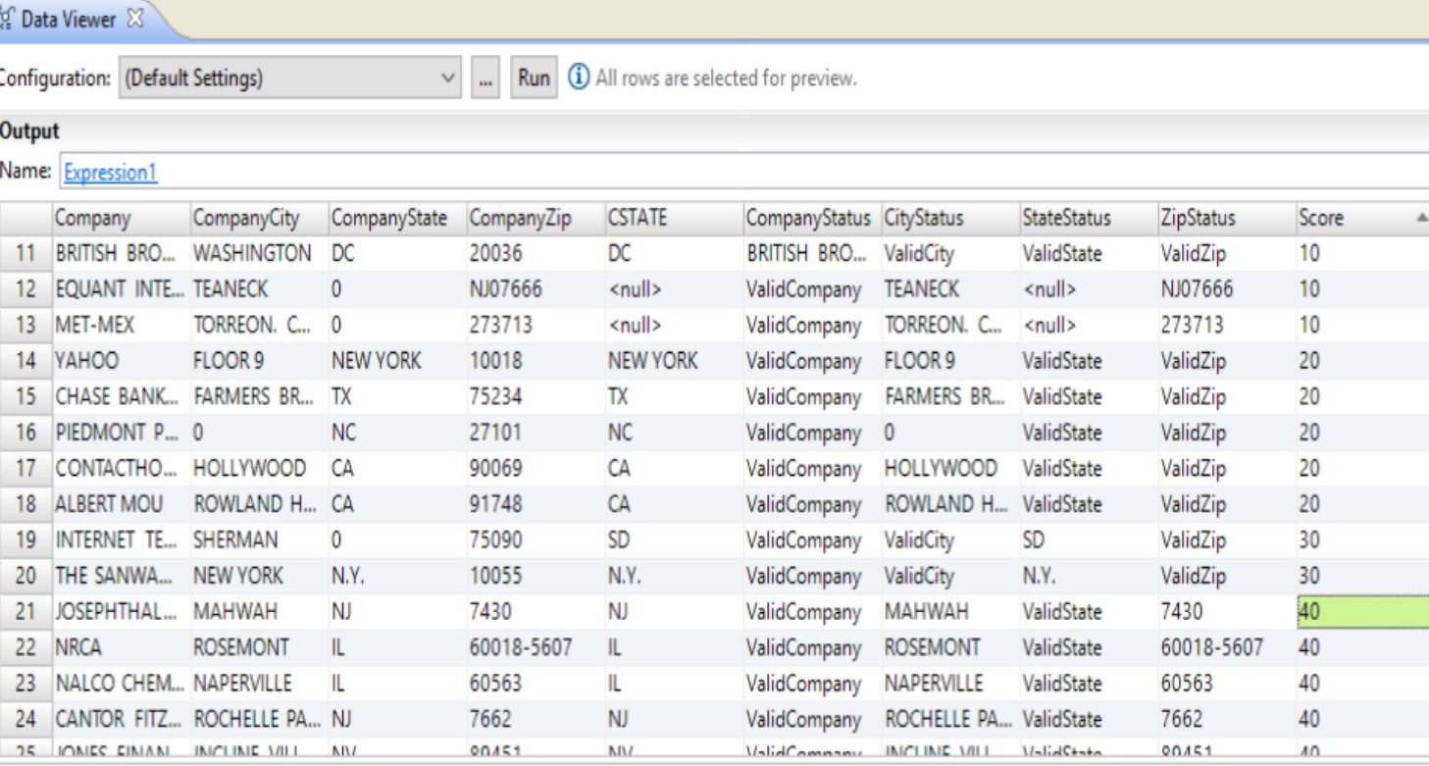

Slide 34
TASK 1H: Add mapplet Input and Output Transformation and Remove Orders (Read) from Mapplet

Slide 35
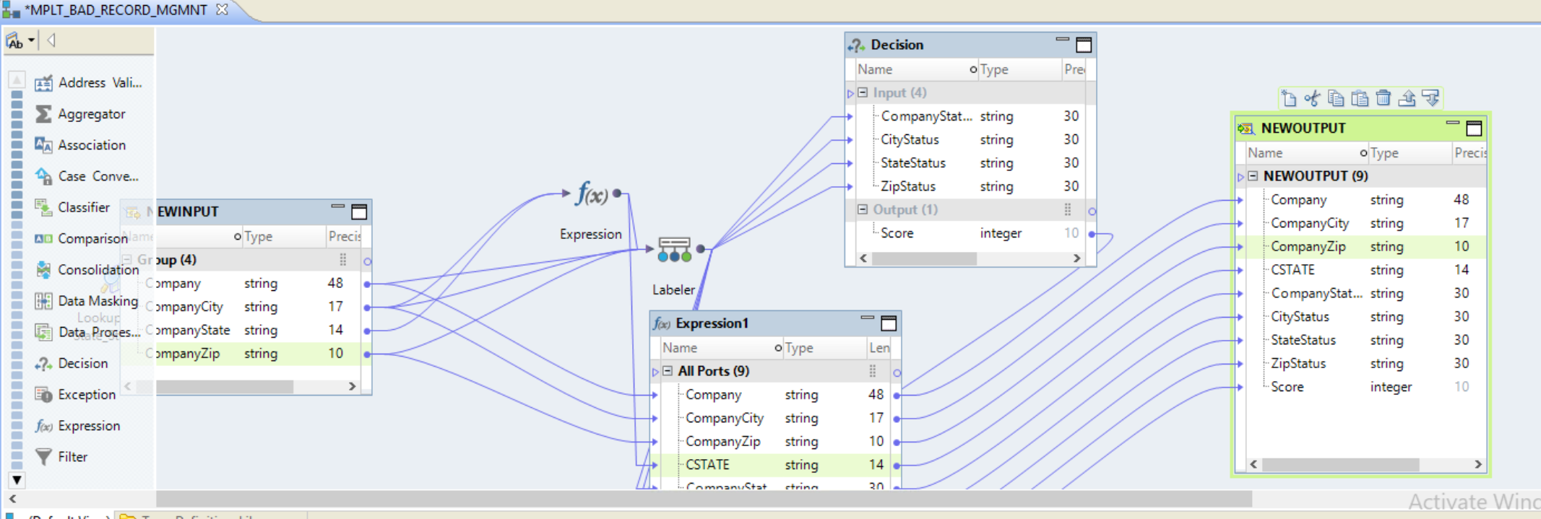
Step 1 : Configure Mapplet
➔ Remove Source ORDERS (Read) from Mapplet
Add Input Transformation , ADD Company, City , State,Zip Column in Input Transformation
Drag Company , City and Zip from input Labeler Transformation
Drag Companystate ,Companycity from INPUT Transformation ➔ Expression transformation
Drag CSTATE from Expression to Labeler transformation
Create OUTPUT Transformation drag all columns from EXPRESSION TO OUTPUT Transformation

Slide 36
Task 2: Create New Mapping to Identify bad records using Exception ➔ Bad Record Management

Slide 37
Task 2A : Create New Mapping

Slide 38
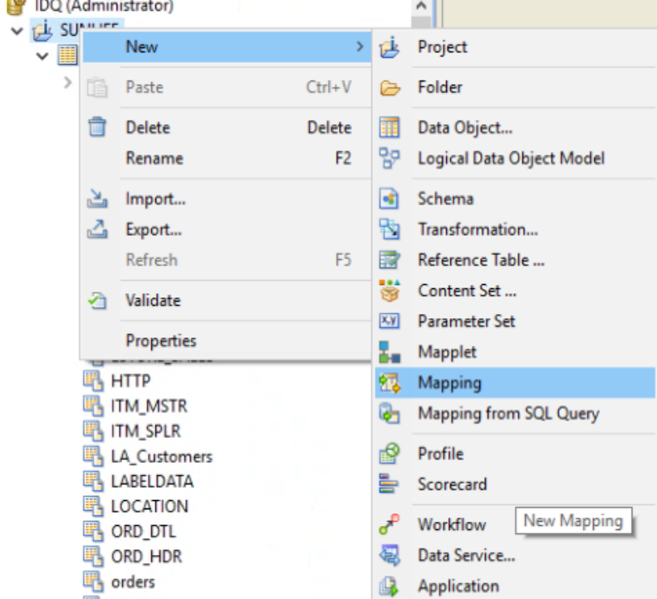
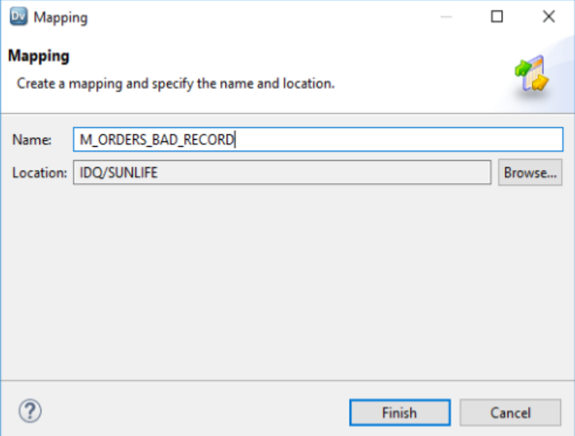
Step 1 : Create New Mapping to Identify Bad Records

Slide 39
Task 2B: Add orders (Read ) + Add mapplet (MPLT_BAD_RECORDS_MGMNT)

Slide 40
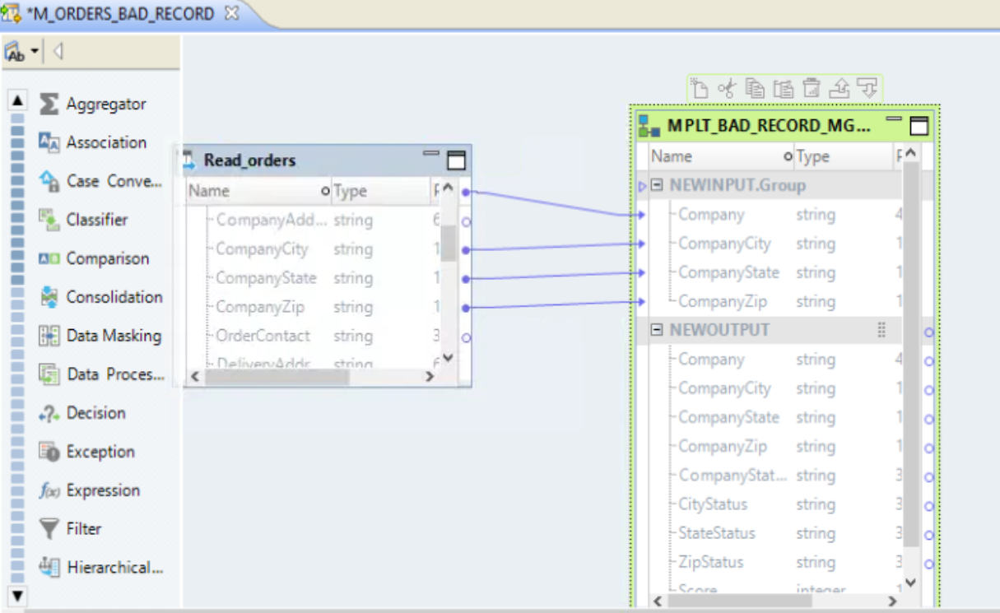
Step 2 : ADD ORDERS (READ) + MAPPLET ( MPLT_BAD_RECORD_MGMNT)

Slide 41
TASK 2C: RUN DATA VIEWER ➔ MAPPLET

Slide 42
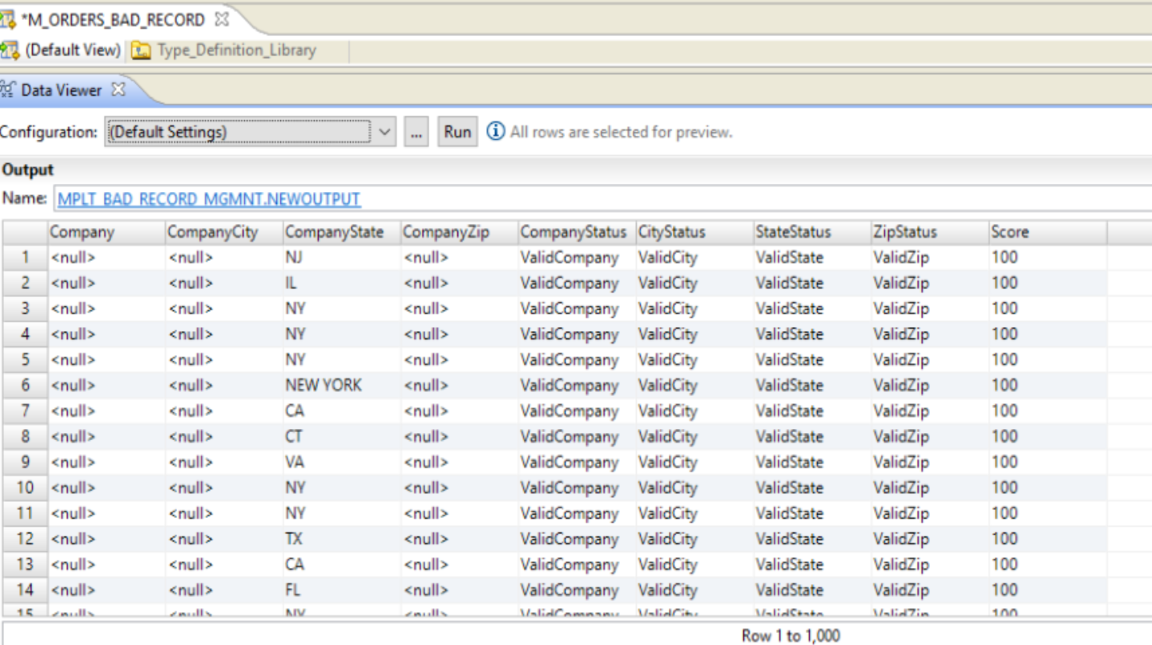
Step 2 : RUN DATA VIEWER

Slide 43
TASK 2D: Add Exception Transformation

Slide 44
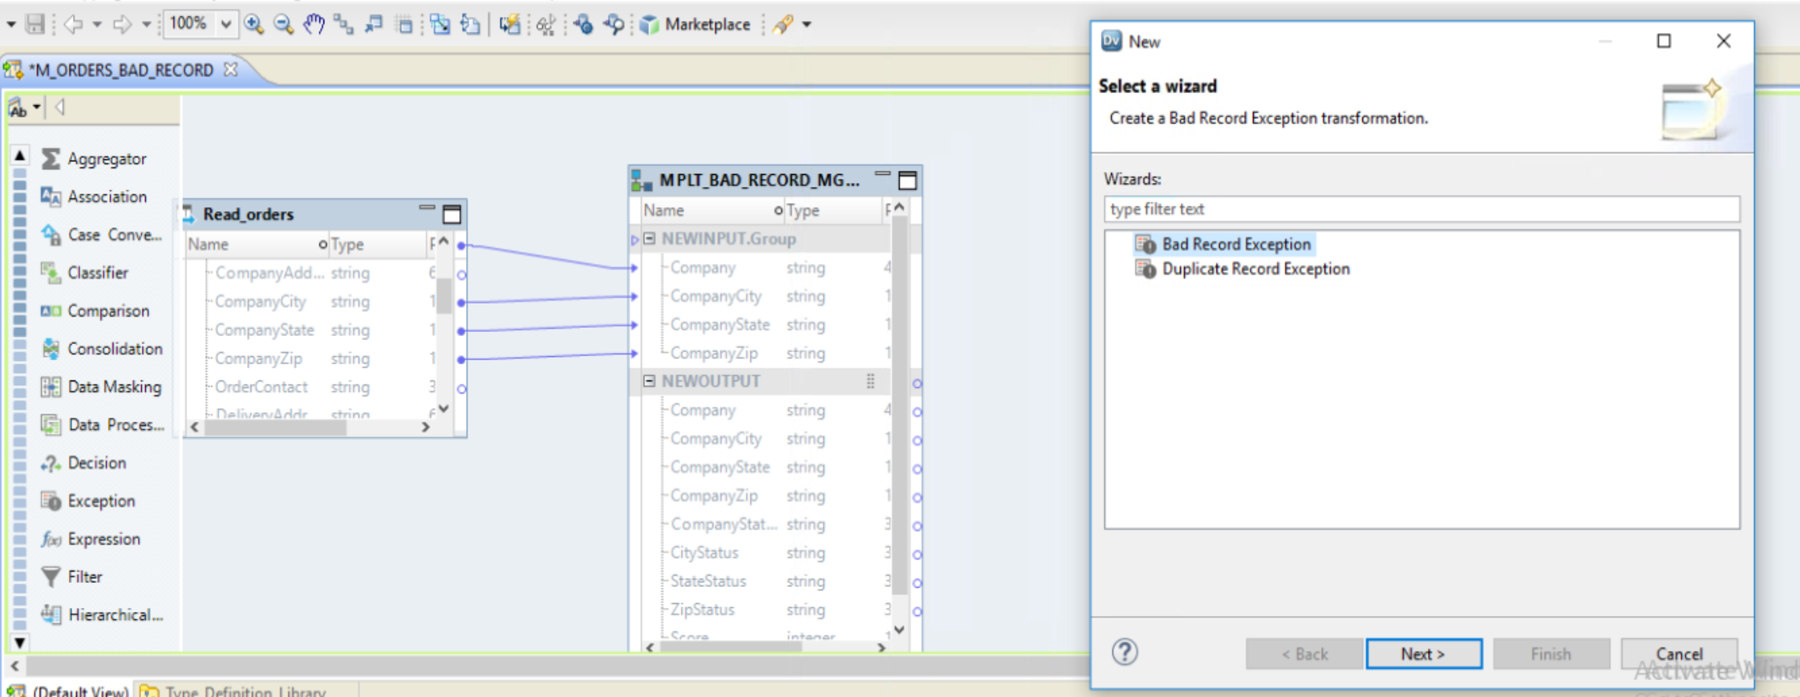
➔ ADD ORDERS (READ ) + ADD MAPPLET ( MPLT_BAD_Record_mgmnt )
Link Company, CompanyCIty,CompanyState & CompanyZip from ORDERS (read) to MPLT_BAD_Record_mgmnt (MPLT)
ADD EXCEPTION TRANSFORMATION ➔ Choose BAD RECORD EXCEPTION

Slide 45
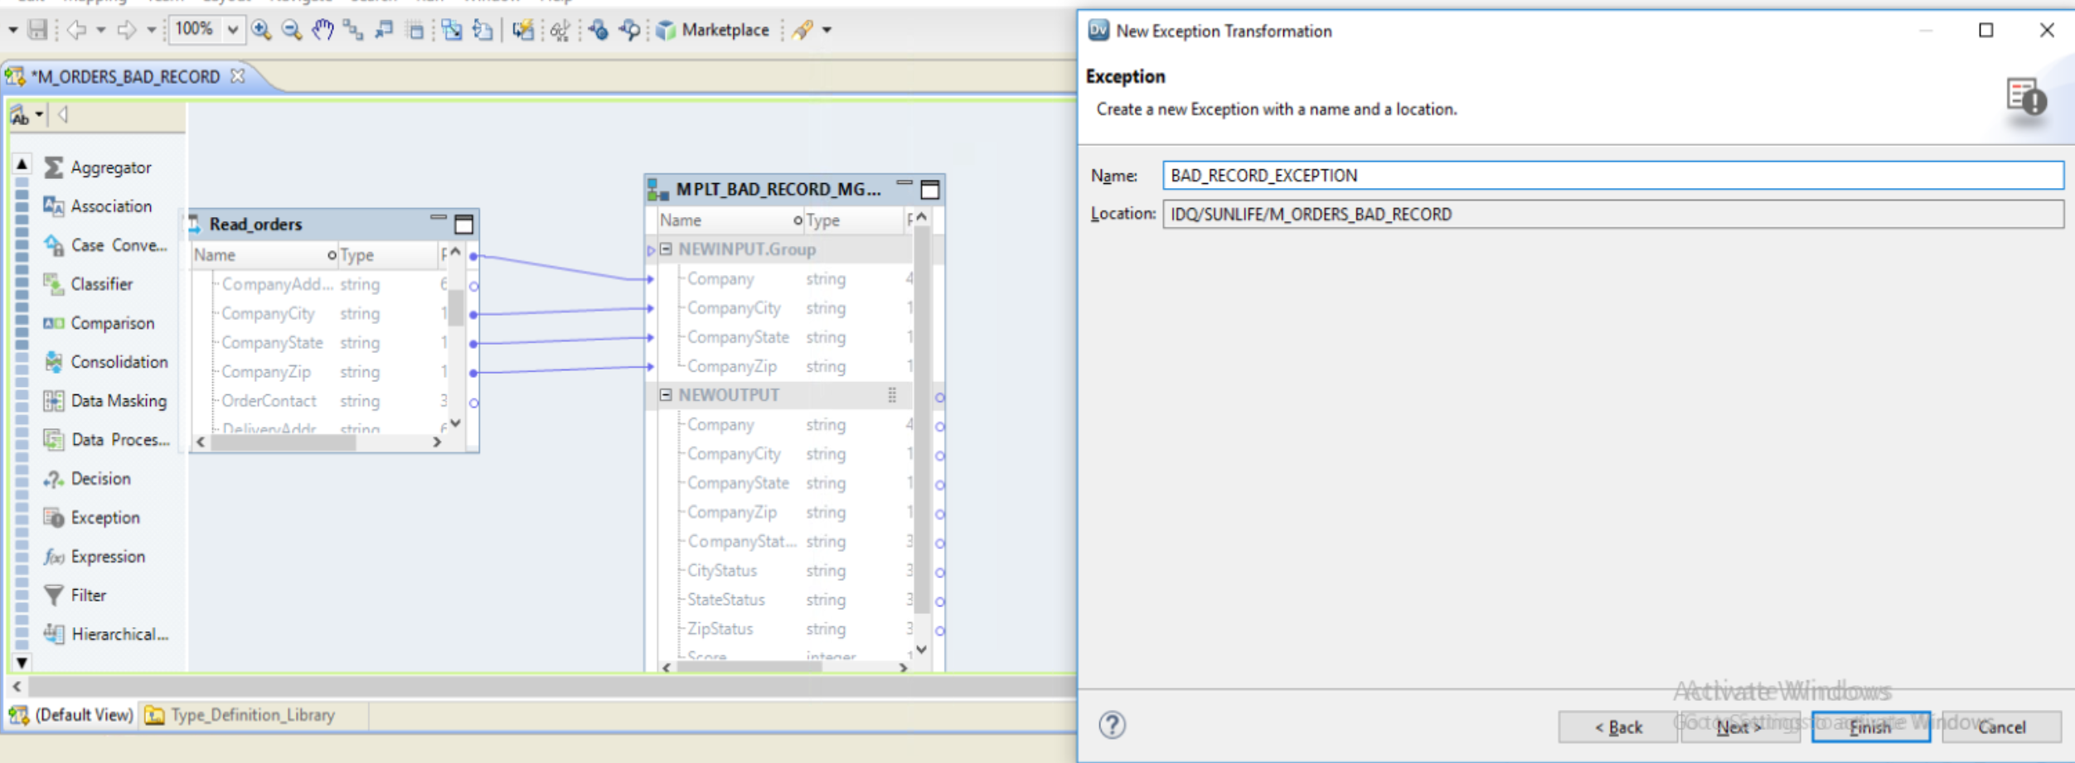
ADD A NEW EXCEPTION TRANSFORMATION ➔ Name ➔ BAD RECORD EXCEPTION

Slide 46
TASK 2D: Exception Transformation ➔ Move Fields to Data Group ➔ Move Score to Control Group

Slide 47
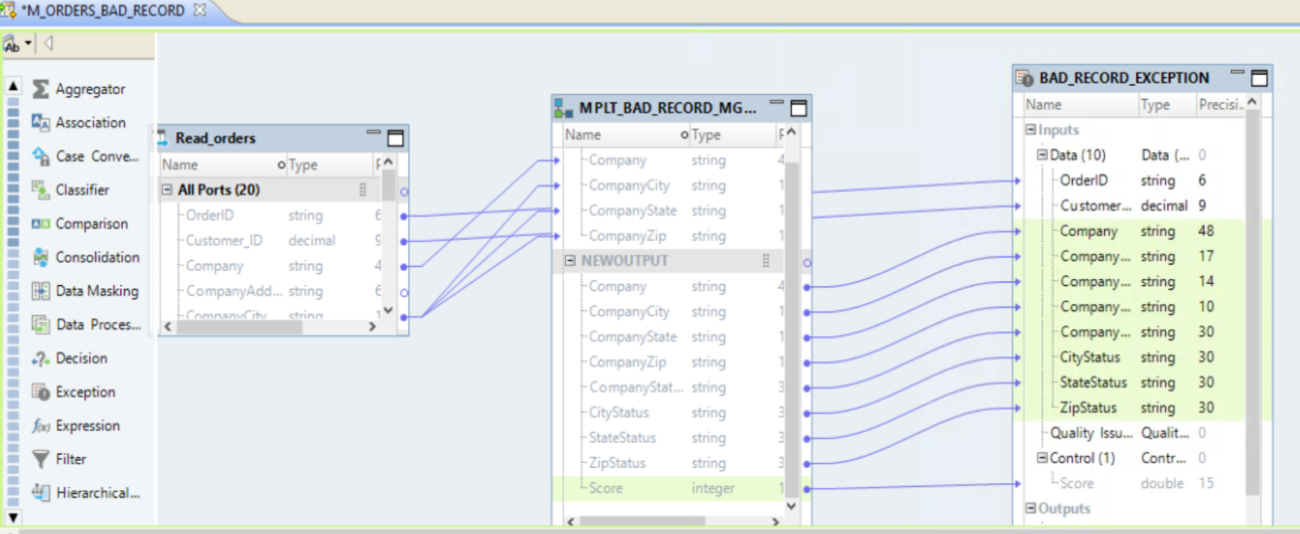
DRAG ORDERID, CUSTOMER_ID COLUMN FROM ORDERS TO EXECEPTION TRANSFORMATION (Data Group)
Move Company,COMPANYCITY,COMPANYSTATE,COMPANYZIP FROM MAPPLET ➔ EXCEPTION Transformation (Data Group)
Move Score ➔ mapplet ➔ EXCEPTION TRANSFORMATION ➔ CONTROL GROUP ( SCORE )

Slide 48
TASK 2E: Exception Transformation ➔ Move Company,City,State Zip to Issue Group

Slide 49
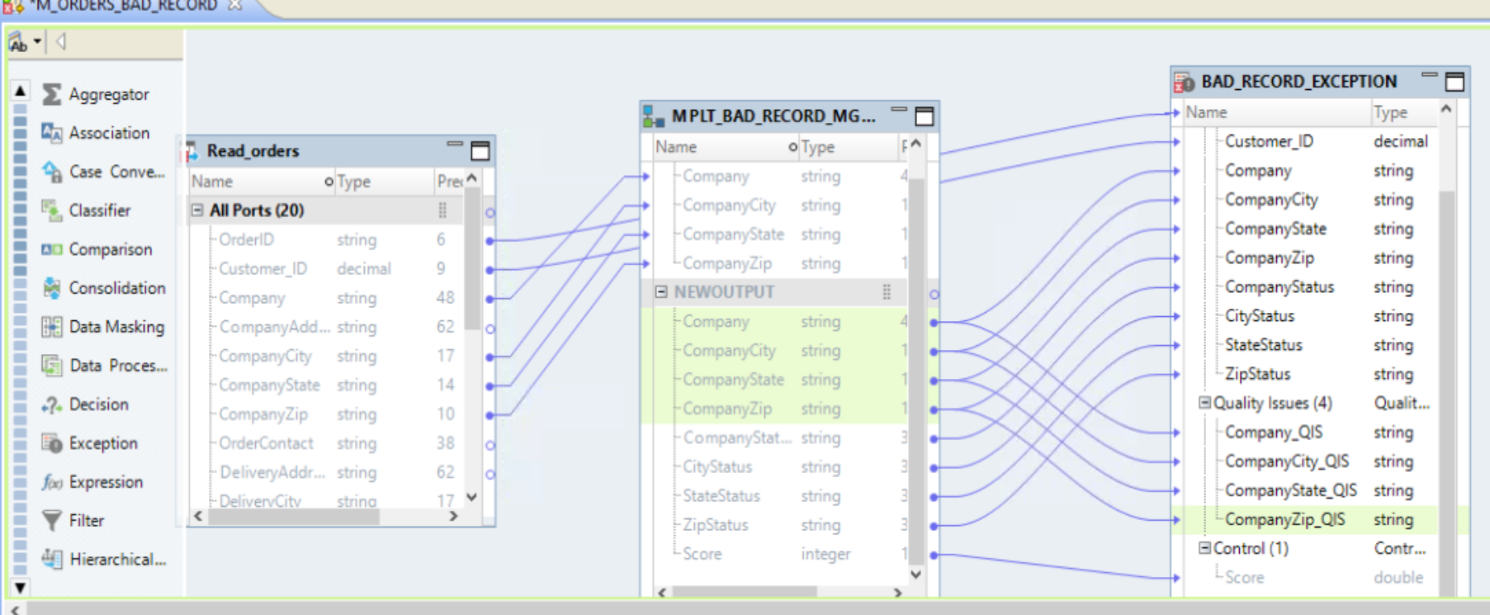
Move Company,COMPANYCITY,COMPANYSTATE,COMPANYZIP FROM MAPPLET➔ EXCEPTION Transformation (QUALITY ISSUE Group and rename the port SUFFIX_QIS)

Slide 50
TASK 2F: Exception Transformation ➔ Configure Threshold

Slide 51
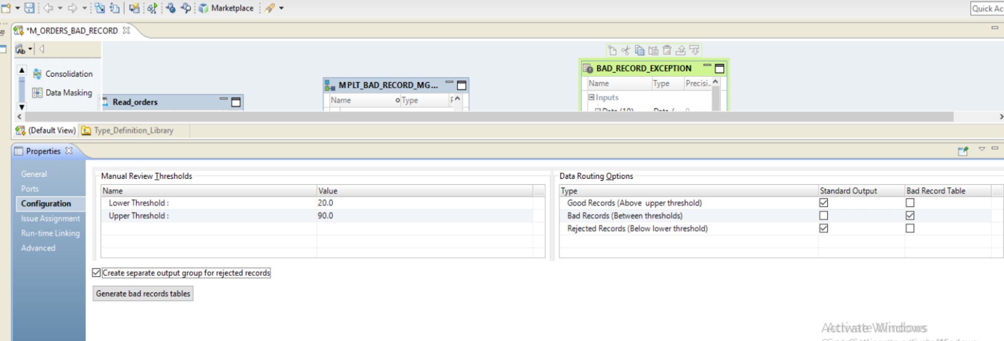
CONFIGURE EXCEPTION THRESHOLD

Slide 52
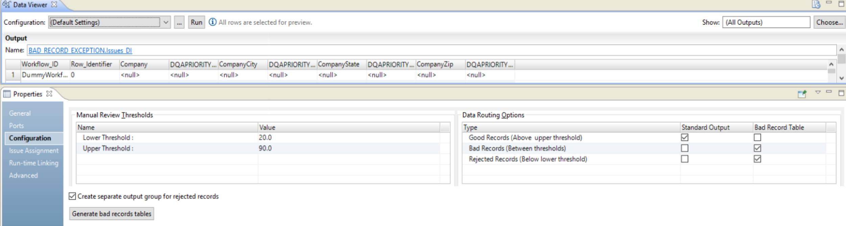
CONFIGURE EXCEPTION ➔ ISSUE MANAGEMENT

Slide 53
TASK 2G: Exception Transformation ➔ Run Data Viewer

Slide 54
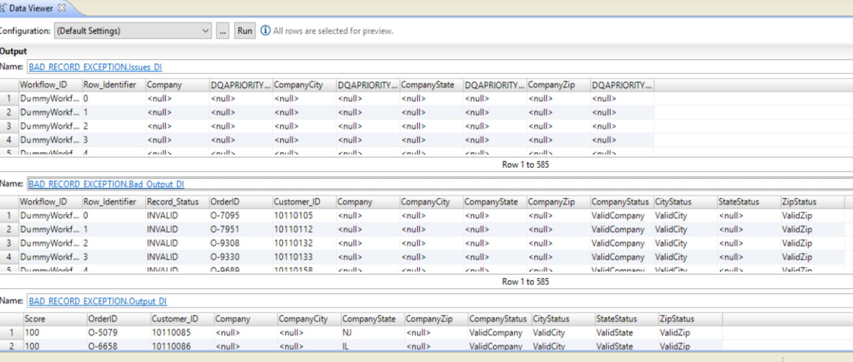
Step 2 :

Slide 55
TASK 2G: Create Target ➔ Standard Output / ➔ Run Data Viewer

Slide 56
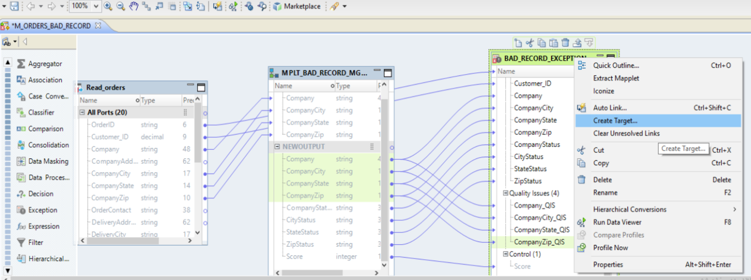
Step 2 :

Slide 57
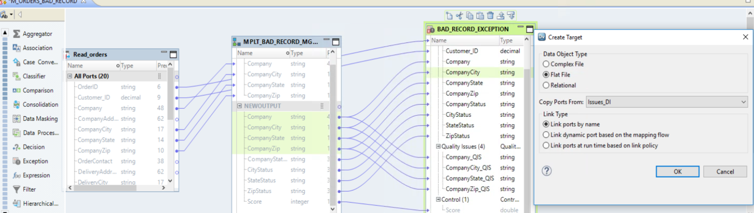
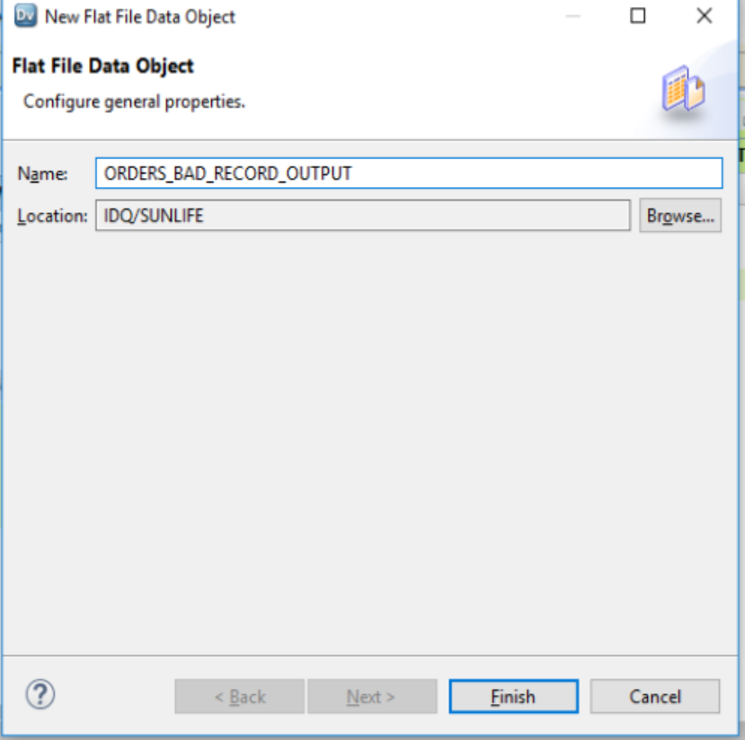
Step 2 :

